Slide 1
NoodleTools and Diigo

Slide 2
NoodleTools
http://www.noodletools.com/
NoodleTool’s Note Taking Feature is outlined in the following PDF on page 63:
NoodleTool's User's Guide

Slide 3
Diigo: Step 1: Sign Up
Create a Diigo Account

Slide 4
Step 2: Add the Diigo Extension

Slide 5
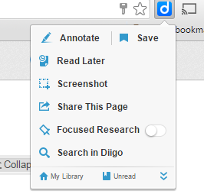
Diigo Extension: Let’s look at our options!

Slide 6
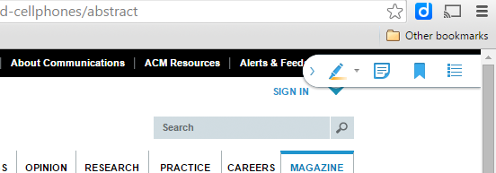
Diigo Tool Bar
Yellow: Highlighter
Blue: Post-It
(this is where you write your annotations; can also be organized by color)
Green: Save (this can be used to edit saved articles, etc.)
Purple: List of your annotations (post-its) of the article

Slide 7
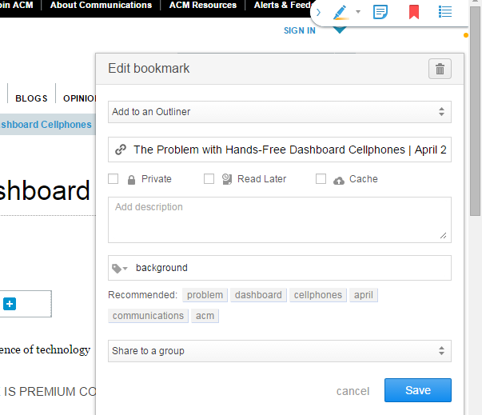
Let’s edit the bookmark of the article we saved…
Yellow: Click to edit
Blue: Create tags to organize

Slide 8
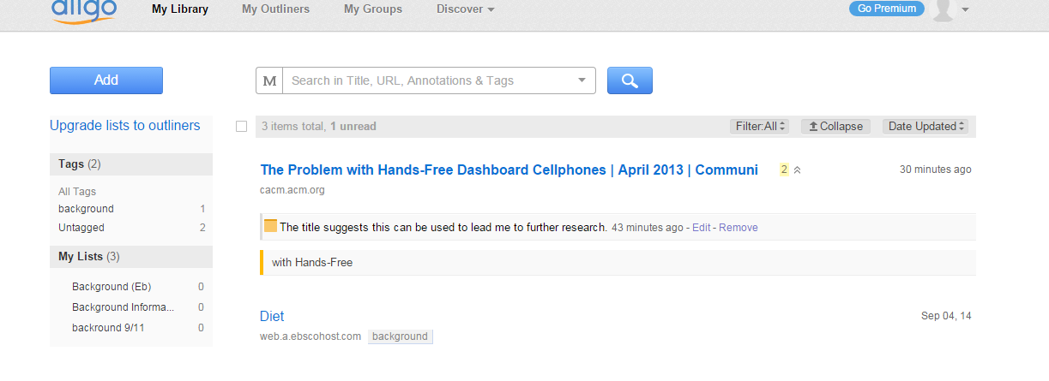
Diigo Library Example

